Slide 1
18css202j Computer communications project NETWORK DESIGN PROPOSAL FOR 3 STAR HOTEL

Slide 2
Abstract
Designing a network architecture has always been a challenging topic and an active research area. The network has to be analysed for it to be consistent and reliable. The network design proposal is made to accommodate the requirements for a 3-star Hotel that has ADSL Internet available for the hotel. The project is focused on WLANs and associated wireless technology. Hence, further to wireless technology, the guide also delves into security issues. The network and devices provided by the management have firewall and security software installed in it. The hardware and tools used for the project are Router, Switch, Desktop, Broadband MODEM / Wireless Router, Ethernet cable, Cisco Packet Tracer to create a prototype for the proposal.
This project will result in understanding how an organization operates its network architecture, how it administers and maintains the security of the network and what are the challenges faced while architecting the network. A prototype was built which simulates the build and function of the network using virtual tools.

Slide 3
OUR team
Sakshi Shruti Anurag Riswadkar Harsh
RA2011003010924 RA2011003010930 RA201100301927
Apoorva Gupta Sri Ram Charan Reddy
RA2011003010897 RA2011003010900

Slide 4
Introduction
Background of the project
Hotel Infrastructure
The hotel has 15 floors with 10 rooms in each floor
The hotel has a lobby area.
The hotel has a swimming pool area.
ADSL Internet is available for the hotel.
Aim:
To prepare the network of a 3 – star hotel as per the hotel management requirements

Slide 5
Literature survey
WIRELESS NETWORK
Admin telecommunications networks are normally introduced and administered using radio communication. This exercise takes place at the physical level of OSI (layer)
The first technical wireless network was established under the brand ALOHAnet at the University of Hawaii in 1969 and became operational in June 1971. The first commercial wireless network was the WaveLAN family of products developed by NCR in 1986.
ROUTERS
The concept of an Interface computer was first proposed by Donald Davies for the NPL network in 1966. The same idea was conceived by Wesley Clark the following year for use in the ARPANET. Named Interface Message Processors (IMPs), these computers had fundamentally the same functionality as a router does today. The idea for a router (called gateways at the time) initially came about through an international group of computer networking researchers called the International Networking Working Group (INWG). Set up in 1972 as an informal group to consider the technical issues involved in connecting different networks, it became a subcommittee of the International Federation for Information Processing later that year. These gateway devices were different from most previous packet switching schemes in two ways. First, they connected dissimilar kinds of networks, such as serial lines and local area networks. Second, they were connectionless devices, which had no role in assuring that traffic was delivered reliably, leaving that entirely to the hosts. This particular idea, the end-to-end principle, had been previously pioneered in the CYCLADES network.

Slide 6
SWITCH
A network switch is a multiport network bridge that uses MAC addresses to forward data at the data link layer (layer 2) of the OSI model. Some switches can also forward data at the network layer (layer 3) by additionally incorporating routing functionality. Such switches are commonly known as layer-3 switches or multilayer switches.
Switches for Ethernet are the most common form of network switch. The first Ethernet switch was introduced by Kalpana in 1990. Switches also exist for other types of networks including Fibre Channel, Asynchronous Transfer Mode,
and InfiniBand.
ADSL
ADSL was specifically designed to exploit the one-way nature of most multimedia communication in which large amounts of information flow toward the user and only a small amount of interactive control information is returned. Several experiments with ADSL to real users began in 1996. In 1998, wide-scale installations began in several parts of the U.S. In 2000 and beyond, ADSL and other forms of DSL are expected to become generally available in urban areas. With ADSL (and other forms of DSL), telephone companies are competing with cable companies and their cable modem services.
Ethernet
Ethernet was developed at Xerox PARC between 1973 and 1974. It was inspired by ALOHAnet, which Robert Metcalfe had studied as part of his PhD dissertation. The idea was first documented in a memo that Metcalfe wrote on May 22, 1973, where he named it after the luminiferous aether once postulated to exist as an "omnipresent, completely-passive medium for the propagation of electromagnetic waves." In 1975, Xerox filed a patent application listing Metcalfe, David Boggs, Chuck Thacker, and Butler Lampson as inventors. In 1976, after the system was deployed at PARC, Metcalfe and Boggs published a seminal paper. Yogen Dalal, Ron Crane, Bob Garner, and Roy Ogus facilitated the upgrade from the original 2.94 Mbit/s protocol to the 10 Mbit/s protocol, which was released to the market in 1980.

Slide 7
Network requirement:
Requirements of this project:
All the rooms should have computers installed.
Swimming pool area and lobby should have internet access.
Guest room should have free internet access.
Hotel management staff and the guests should be on different networks.
15 users in hotel management who require computers.
Wireless access in lobby and swimming pool are should be secure.

Slide 8
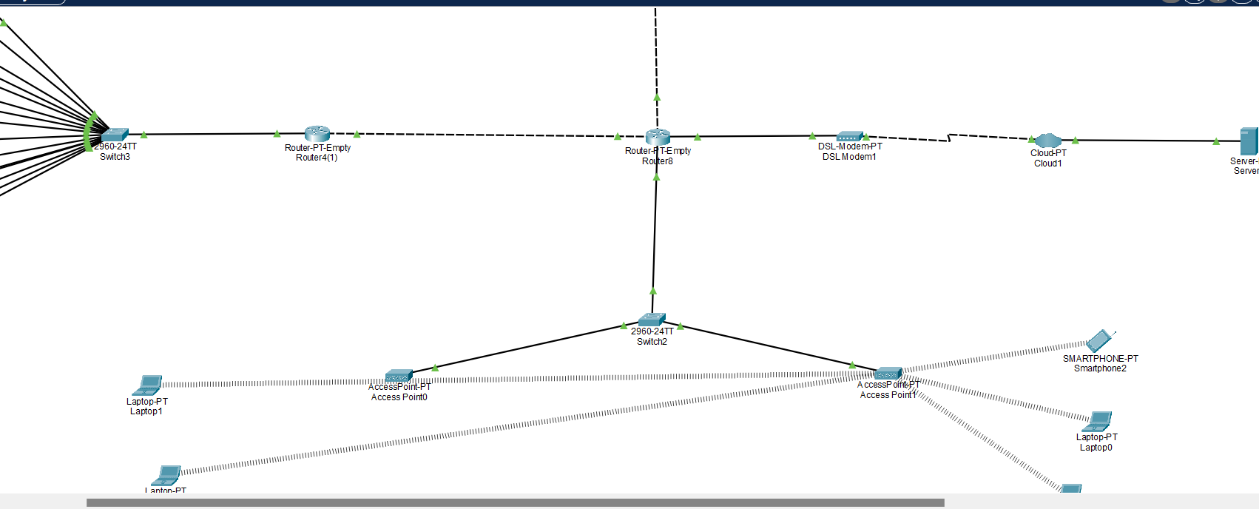
Network design and architecture

Slide 9
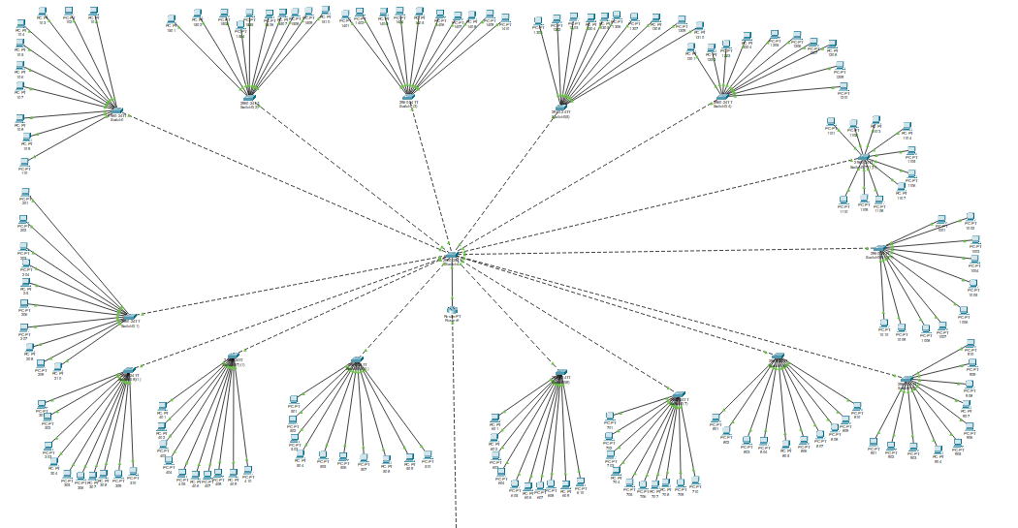
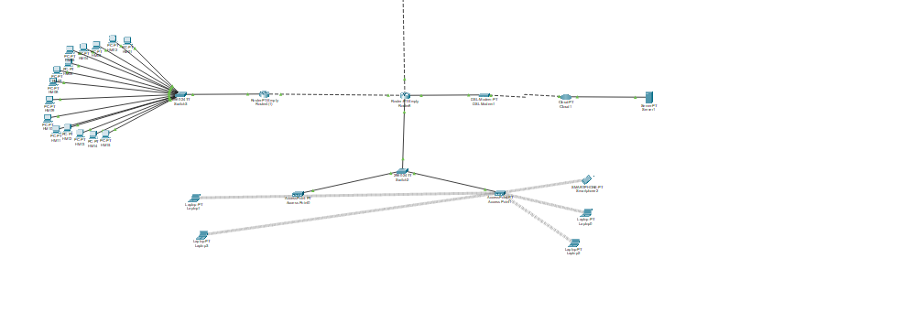

Slide 10
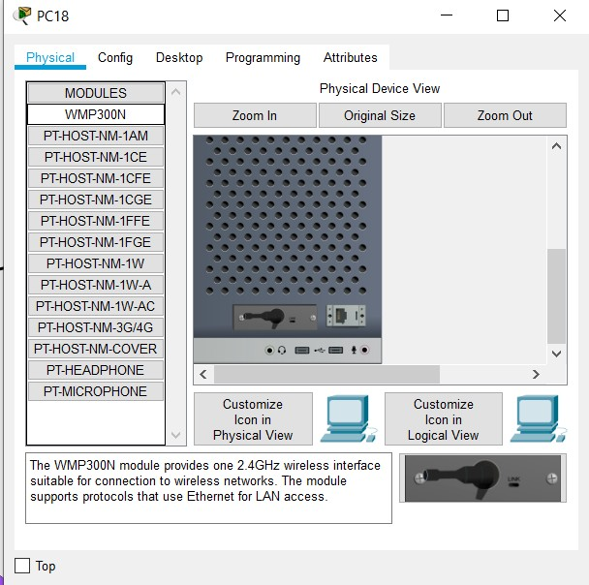
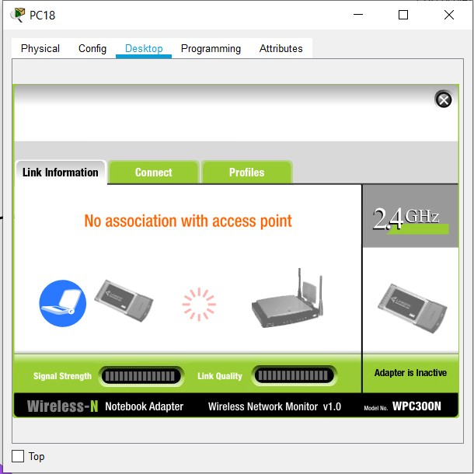
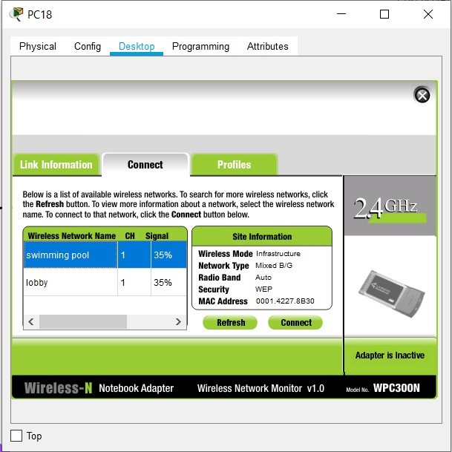
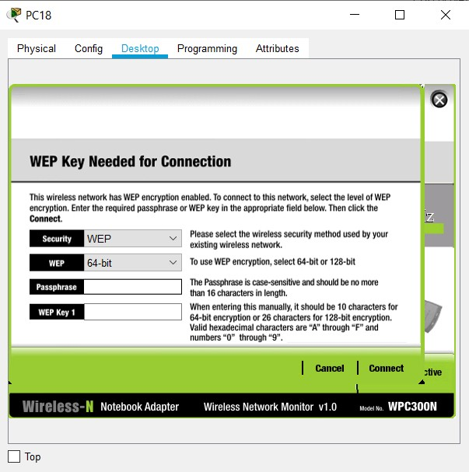

Slide 11
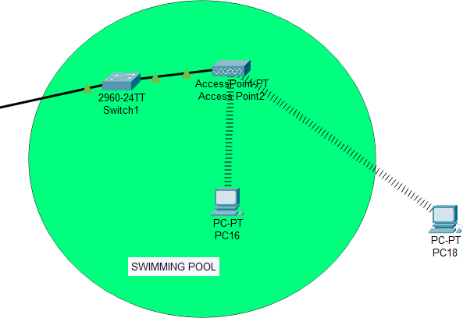
We are testing the Wi - Fi by bringing in a new PC and connecting it with the Wi - Fi. As we can see in the 4th image that both of the Wi - Fi are discoverable which shows that both of them are functioning properly.
When the user selects the required Wi - Fi and taps connect, he/she is asked to provide password for the Wi - Fi in the 5th image. On providing the correct password the PC get connected which we can see in the last image.

Slide 12
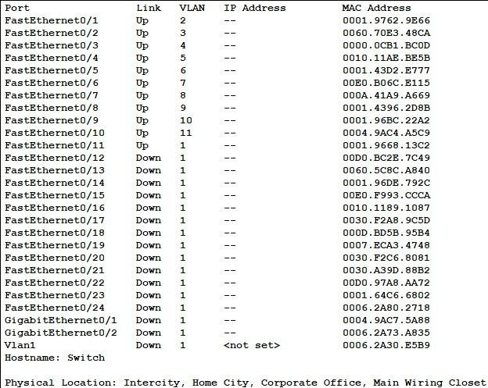
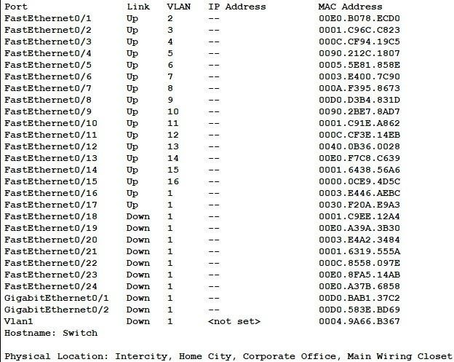

Slide 13
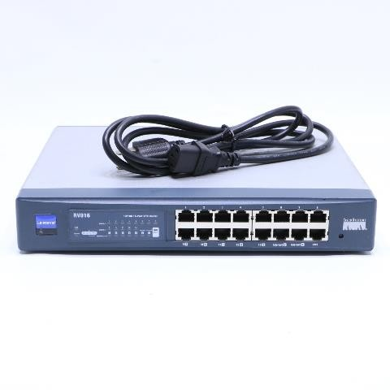
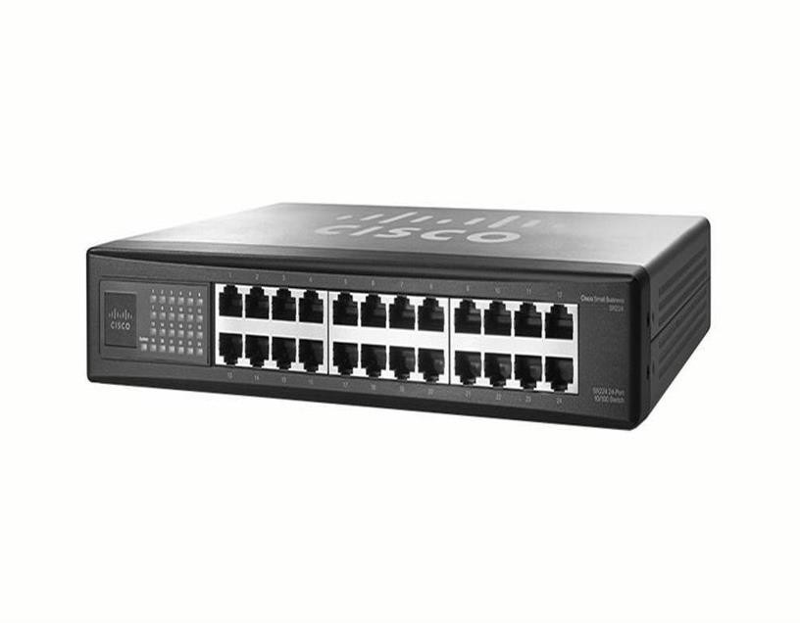
Recommended products
CISCO LINKSYS RV016 10/100 16-PORT VPN ROUTER -B2
Switch Cisco SF 100-24 24-Port 10/100 SR224T

Slide 14
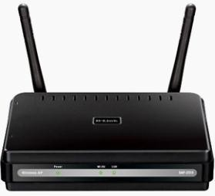
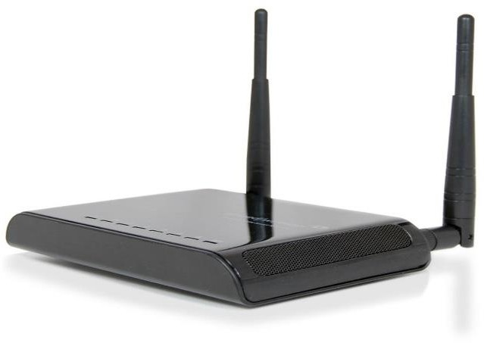
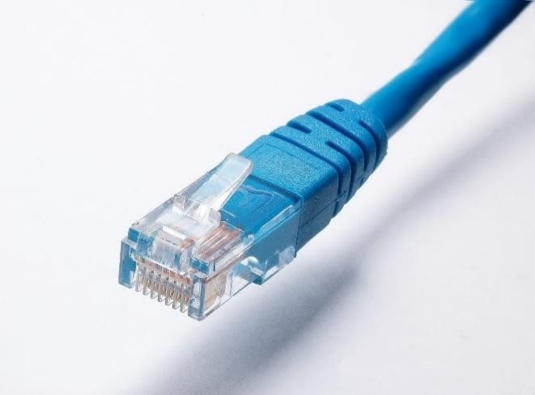
Wireless Access Point Type of DAP-2310
Amped Wireless SR300 High Power Wireless-300N Smart Repeater
Media Bridge FBA 31-299-100B - Highly Durable Ethernet Cable

Slide 15
References
http://www.dlink.com/us/en/business-solutions/wireless/access-points/access-
points/dap-2310-airpremier-n-high-port-access-point
http://www.cisco.com/en/US/products/ps9924/
http://shopper.cnet.com/repeaters/amped-wireless-sr300-high/4014-3297_9-
35144068.html?tag=mncol;lst
http://saudi.souq.com/sa-en/switch-cisco-sf-100-24-24-port-10-100-sr224t-
4580617/i/?gclid=CLL5l4SLrLsCFWbLtAodUw0ABQ

Slide 16
Conclusion
We construct the require network for 3 –star hotel as per the requirements of hotel management successfully and connected them successfully ….

Slide 17
Thank you

